Slide 1
Stop, Drop, & Adopt
Kendra Elliott
Sr. Customer Success Manager
Kelsey Furney
Customer Success Manager
January 28, 2020

Slide 2
Agenda
Introductions
Objective
Launch Kit Overview
Adoption Planning Tools/Templates-STOP
Communication Tools/Templates-DROP
Create on-going Apptio Buzz-ADOPT
Q&A

Slide 3
Objective
The purpose of this session is to explore collateral to increase the usage and adoption of Apptio within your organization. We will explore content within the launch kit and provide tips and tricks to drive ongoing adoption. This information has been compiled using information from TBM Connect, Apptio CSM’s and ideas provided by other organizations.

Slide 4
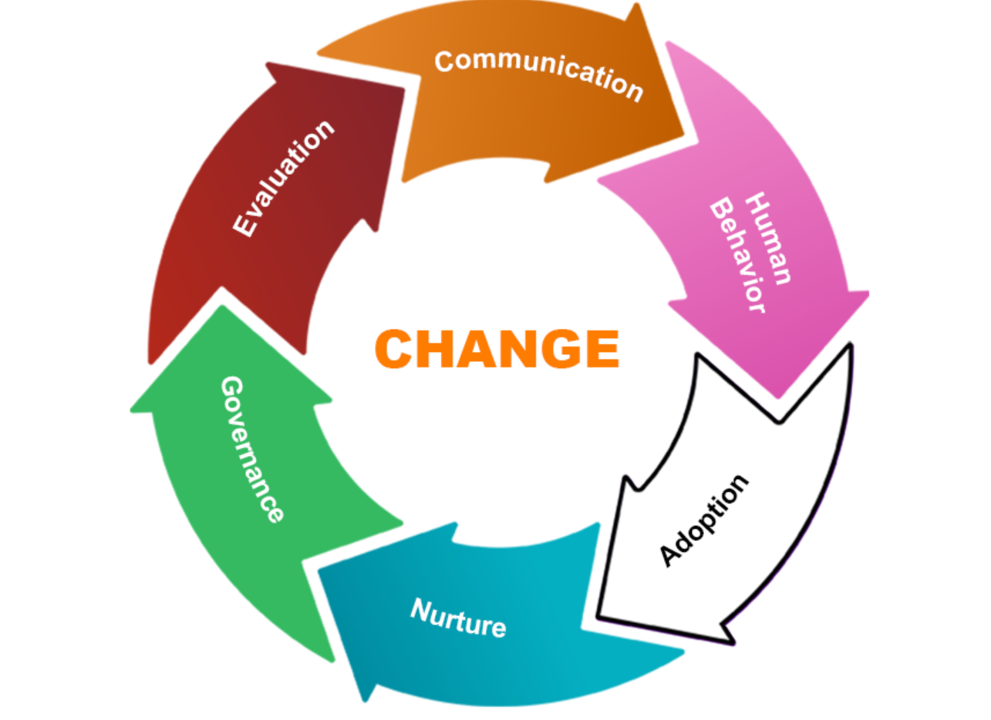
Launch Kit Overview
The launch kit is a compilation of best practices and communications to aid in launching Apptio within your organization. Here you will find sample communication templates to help ensure your organization will be wildly successful!
Apptio Launch Kit

Slide 5
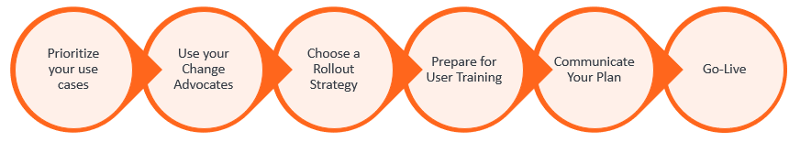
Adoption Framework-STOP
Design Your Rollout Strategy
Sample Rollout Plan
Sample Rollout Timelines
End-user Training Checklist
Customizable End-User Content
Notes:
Design your rollout strategy Link: https://tbmcouncil.jiveon.com/docs/DOC-11431
Prioritize your use cases-What use cases are you rolling out initially..importance/stack rank
Use your change advocates-What use cases are important to them..should I use the change advocates as my initial rollout group
Choose a rollout strategy-big bang, phased, stakeholder, just within the TBM office
Prepare for User Training-Based off previous points tailor training to that audience
Communicate your plan-We will talk about a good template later on to help build your comm plan and share out
Go-Live

Slide 6
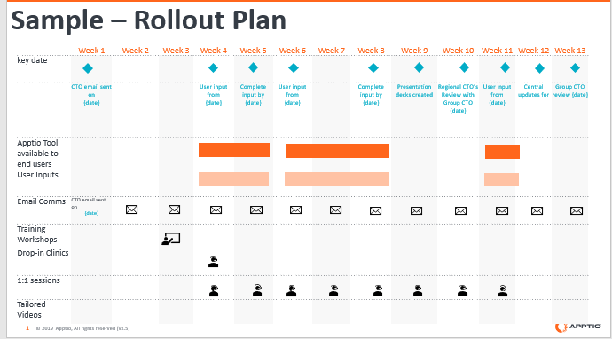
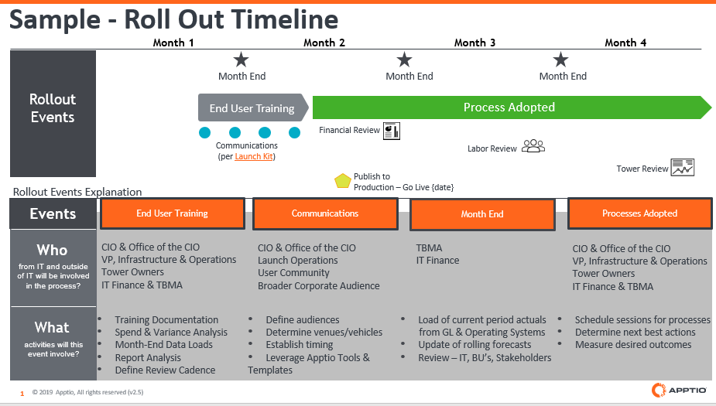
Sample Rollout Timeline and Plan
Notes:
Sample Rollout Plan: https://tbmcouncil.jiveon.com/docs/DOC-11436
Sample Rollout Timeline: https://tbmcouncil.jiveon.com/docs/DOC-11437

Slide 7
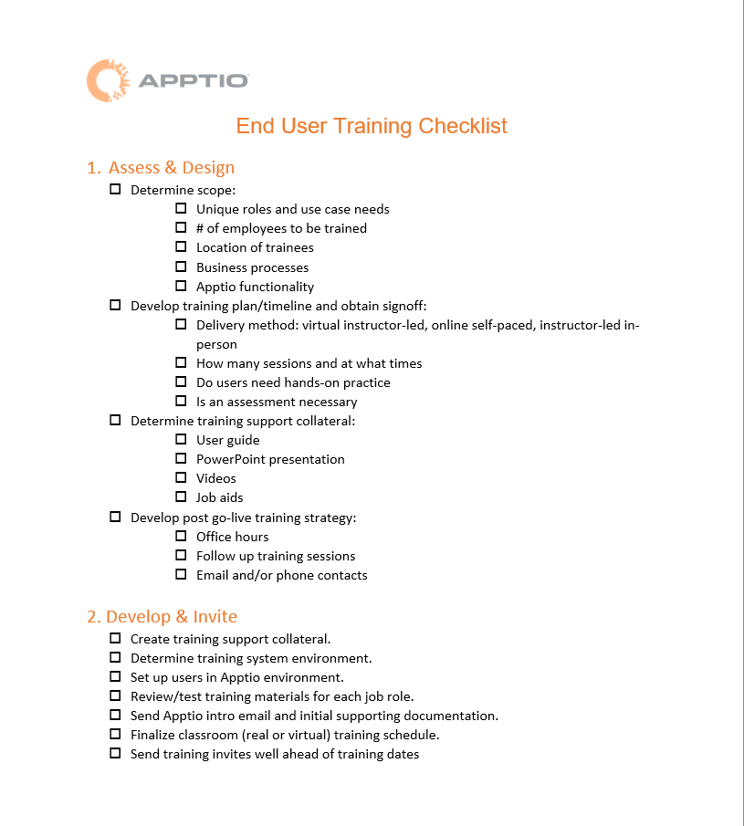
End-user Training Checklist
Notes:
End User Training Checklist-https://tbmcouncil.jiveon.com/docs/DOC-11160

Slide 8
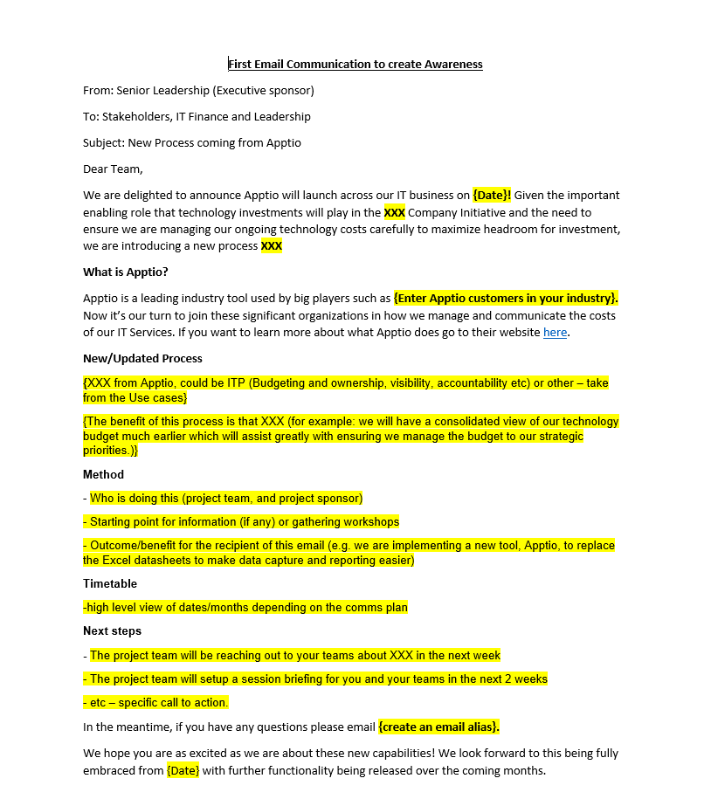
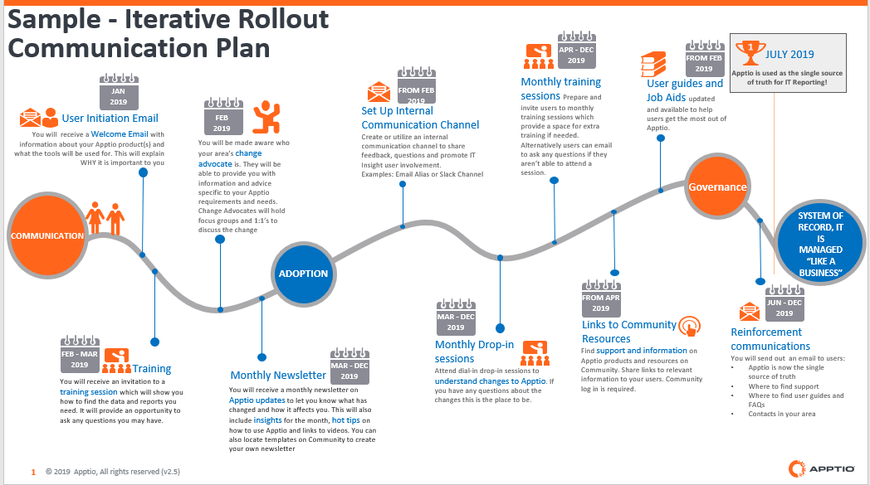
Communication Tools/Templates-DROP
Communication Plan Strategy Template
Introduction to TBM & Apptio
ATUM Poster
Email Template
Notes:
Communication Plan Template: https://tbmcouncil.jiveon.com/docs/DOC-11510
Email Communication Template: https://tbmcouncil.jiveon.com/docs/DOC-11417
ATUM Poster –https://tbmcouncil.jiveon.com/docs/DOC-11636
The introduction to Apptio and TBM videos: https://s3-us-west-2.amazonaws.com/communityfiles.apptio.com/Education+Services/Getting_to_Know_Apptio_and_TBM.html
TBM Connect registration link: https://tbmcouncil.jiveon.com/create-account.jspa

Slide 9

Create on-going Apptio Buzz-ADOPT
TBM Poster
Email Signature
Apptio Newsletter
Notes:
TBM Poster-https://tbmcouncil.jiveon.com/docs/DOC-6199

Slide 10
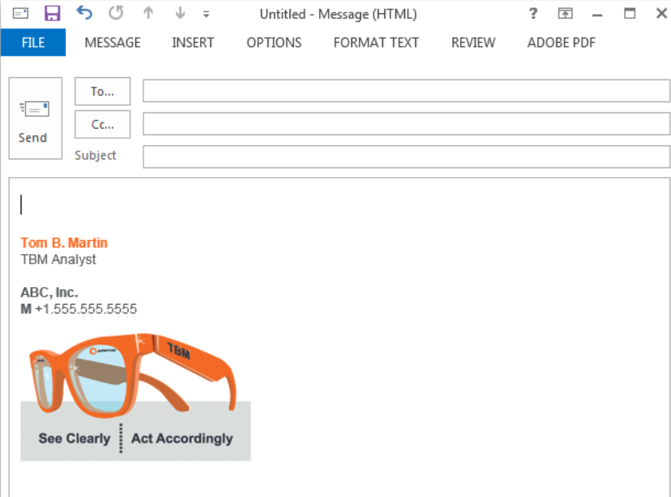
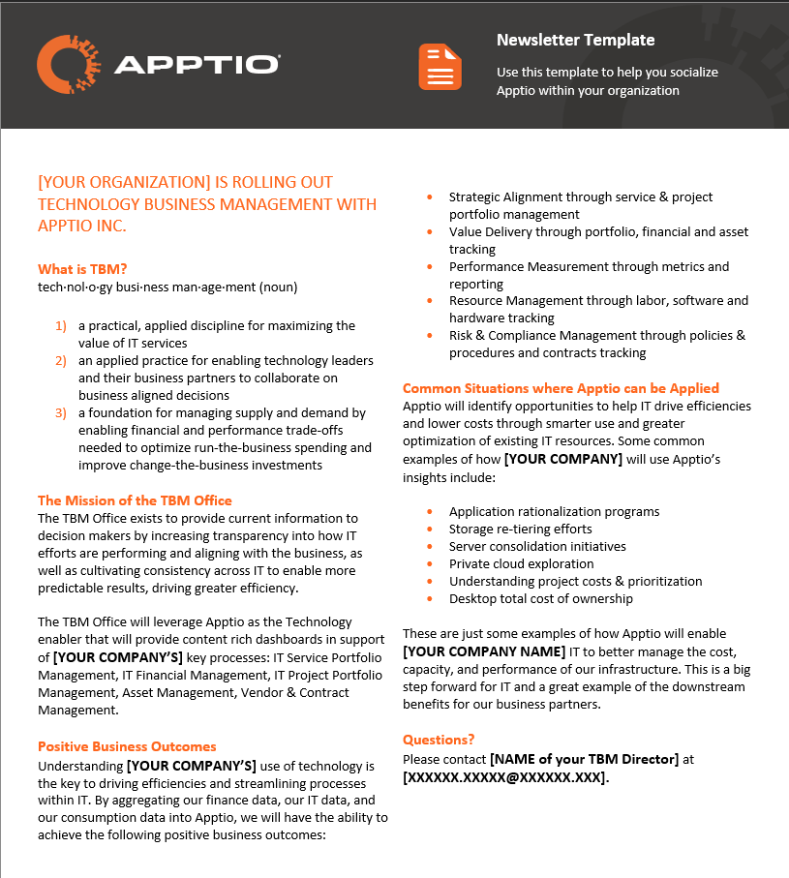
Email Signature and Newsletter
Notes:
Apptio Newsletter Link: https://tbmcouncil.jiveon.com/docs/DOC-11316
Email Signature: https://tbmcouncil.jiveon.com/docs/DOC-11536

Slide 11
THANK YOU

Slide 12
Questions???
Notes:
Closing content..6 webinars posted..
Thank you for joining this CSM Live session on adoption. We want to hear from you on ideas for future topics. We posted a discussion on the CSM Live group page for you to share your ideas for future CSM Live Topics. Please also remember to follow the page or visit it periodically for a list of upcoming events. I will be posting the slidedeck and the recording later this week. Please reach out to you CSM with any additional questions.

